Slide 1
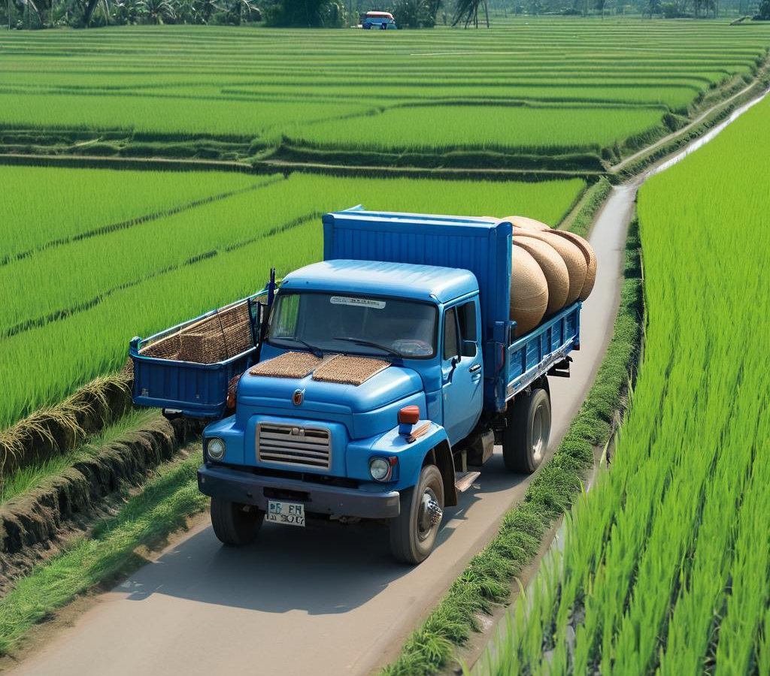
Predictive maintenance: ML-based soft-sensors in transportation operation.
Dharshan a
Pravin rf
Rishikaandh
Abinayaa mk

Slide 2
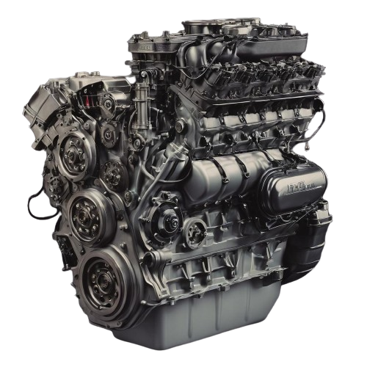
PROBLEM STATEMENT:
Predictive Maintenance for Transportation:
Implement AI predictive maintenance for transportation vehicles.
Utilize real-time data to anticipate and prevent disruptions.
Minimize downtime and reduce maintenance costs.
Enhance vehicle reliability for uninterrupted operations.
Optimize maintenance schedules for efficient transportation of produce.

Slide 3
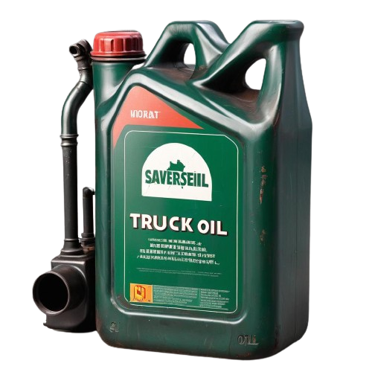
OBJECTIVES:
Implements AI-driven predictive maintenance for vehicles.
Collects real-time sensor data and preprocesses it for reliability.
Utilizes GBM neural networks to forecast maintenance needs.
Integrates a web application interface for real-time data and predictions.
Enables proactive fleet management, cost reduction, and efficient transportation.

Slide 4
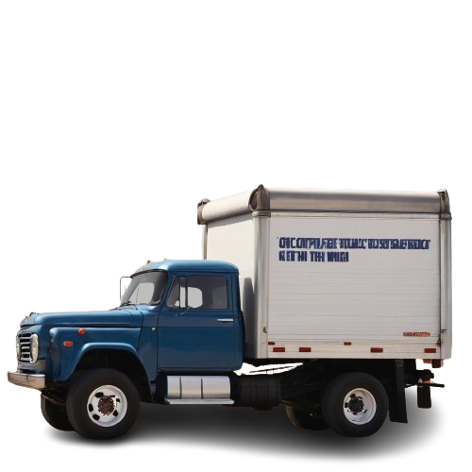
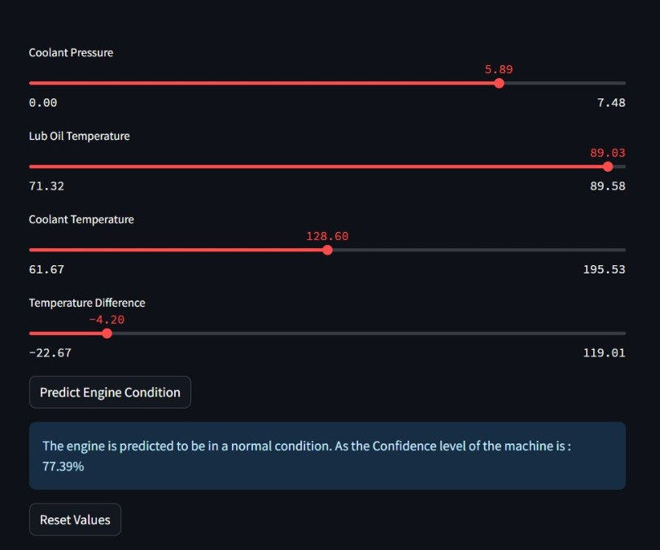
DATA PREPROCESSING: ADDRESSED MISSING VALUES, NAN VALUES BY REPLACING THEM WITH MEAN VALUES. Z-SCORE TO REMOVE OUTLIERS DERRIVED NEW FEATURES CALLED TEMPERATURE DIFFERENCE
DATA COLLECTION: ACQUISITION OF INPUT PARAMETERS THROUGH PHYSICAL SENSORS.
MODEL 1: GRADIENT BOOSTING CLASSIFIER: Excels with complex feature-target relationships.
SELECTION OF INPUT PARAMETERS: ENGINE RPM, LUB OIL PRESSURE, FUEL PRESSURE, COOLANT PRESSURE, TEMPERATURE DIFFERENCE.
POST-PROCESSING: PROBABILITY BASED MAINTENANCE ESTIMATION

Slide 5
GRADIENT BOOSTING CLASSIFIER:
GBM is an ensemble learning method for regression and classification tasks.
It uses decision trees as base learners, typically shallow ones.
Trees are added sequentially, each correcting errors made by previous ones.
GBM minimizes loss function iteratively using gradient descent optimization.
Hyperparameters are tuned for optimal performance, and feature importance analysis provides insight into predictive factors.

Slide 6
POST-PROCESSING:
Predicts maintenance probability based on model output.
Estimates maintenance date 2-3 weeks in advance.
Provides probability percentage for potential part failure.
Enhances predictive accuracy and allows proactive intervention.
Facilitates timely maintenance scheduling to minimize downtime.

Slide 7
BENEFITS:
PERFORMING MAINTAINENCE TIME TO TIME.
OPTIMIZES RESOURCES AND PREVENTS EMERGENCY REPAIRS BEFORE EMBARKING ON LONG JOURNEY.
SAFETY ENHANCEMENTS.
ENHANCING SUPPY CHAIN EFFICIENCY AND CUSTOMER SATISFACTION.

Slide 8
CONCLUSION:
In conclusion, our project revolutionizes transportation maintenance by proactively addressing issues before they disrupt operations.
By leveraging AI, we minimize downtime, cut costs, and boost vehicle reliability.
This ensures a seamless flow of produce, enhancing efficiency and safety for all stakeholders.

Slide 9
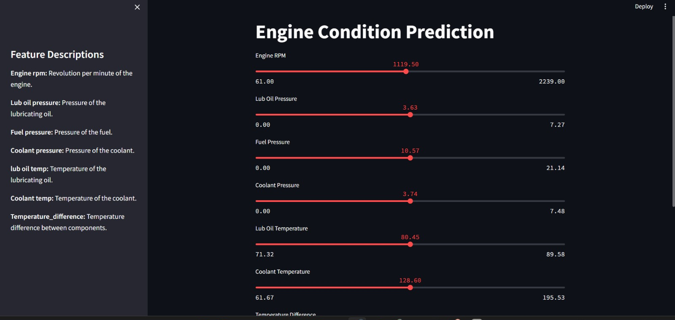

Slide 10
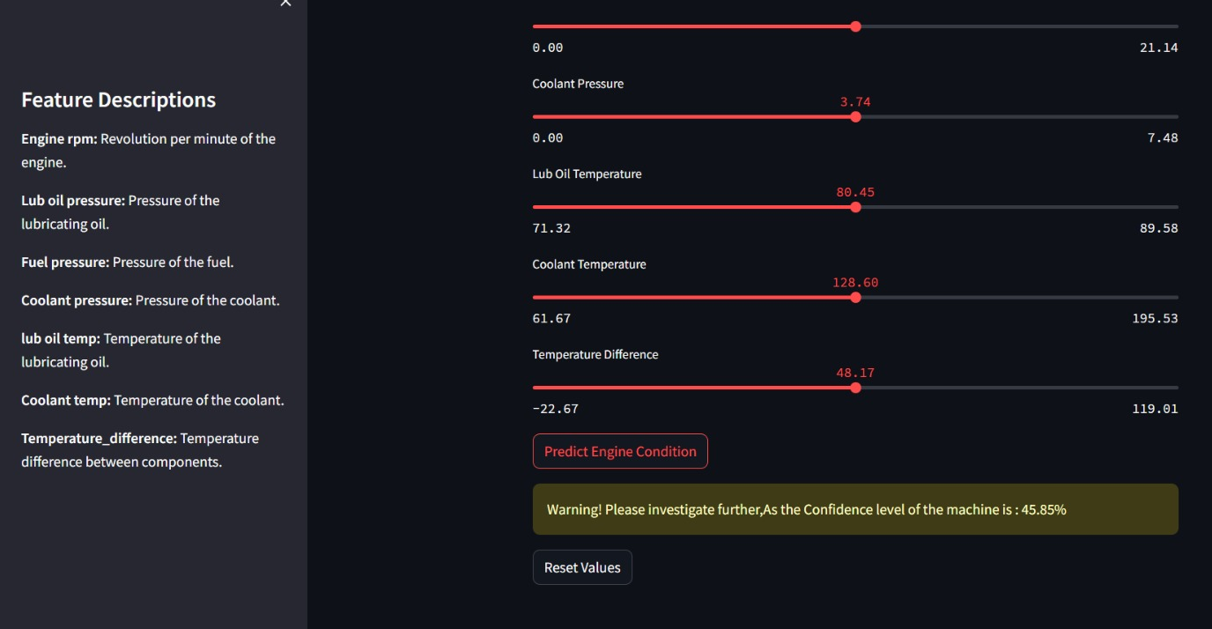
RESULT:

